Slide 1
<DATA STRUCTURES AND ALGORITHM>

Slide 2
V. ARRAYS AND LINKED LIST

Slide 3
ARRAYS

Slide 4
ARRAYS
Arrays are defined as the collection of similar type of data items stored at contiguous memory locations.
Arrays are the derived data type in C programming language which can store the primitive type of data such as int, char, double, float, etc.
Array is the simplest data structure where each data element can be randomly accessed by using its index number.

Slide 5
PROPERTIES OF THE ARRAY
Each element is of same data type and carries a same size i.e. int = 4 bytes.
Elements of the array are stored at contiguous memory locations where the first element is stored at the smallest memory location.
Elements of the array can be randomly accessed since we can calculate the address of each element of the array with the given base address and the size of data element.

Slide 6
ADVANTAGES OF ARRAY
Random access of elements using array index.
Use of fewer line of code as it creates a single array of multiple elements.
Easy access to all the elements.
Traversal through the array becomes easy using a single loop.

Slide 7
DISADVANTAGES OF ARRAY
Allows a fixed number of elements to be entered which is decided at the time of declaration. Unlike a linked list, an array in C is not dynamic.
Insertion and deletion of elements can be costly since the elements are needed to be managed in accordance with the new memory allocation.

Slide 8
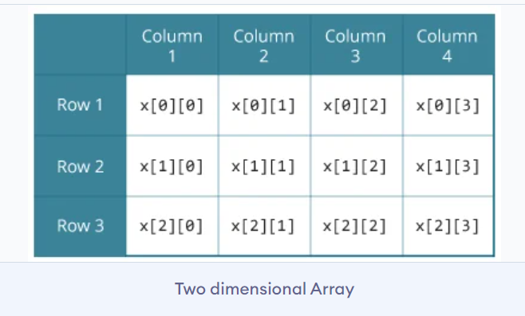
MULTIDIMENSIONAL ARRAYS
An array of arrays.

Slide 9
LINKED LIST

Slide 10
LINKED LIST
A linked list is a data structure used for storing collections of data. A linked list has the following properties:
• Successive elements are connected by pointers
• The last element points to NULL
• Can grow or shrink in size during execution of a program
• Can be made just as long as required (until systems memory exhausts)
• Does not waste memory space (but takes some extra memory for pointers). It allocates memory as list grows.

Slide 11
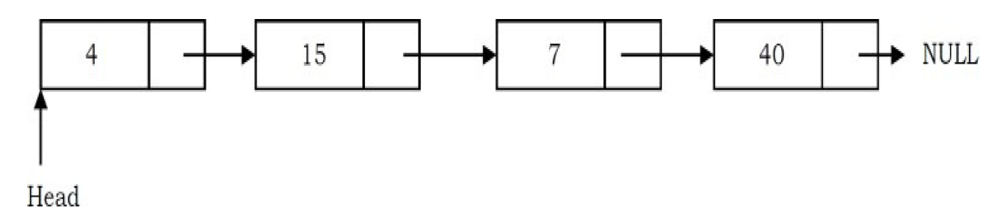
LINKED LIST

Slide 12
MAIN LINKED LIST OPERATIONS
Insert: inserts an element into the list
Delete: removes and returns the specified position element from the list
Display: It is performed to display the elements of the list.
Search: It is performed to search an element from the list using the given key.

Slide 13
ADVANTAGED OF LINKED LISTS
Linked lists have both advantages and disadvantages. The advantage of linked lists is that they can be expanded in constant time. To create an array, we must allocate memory for a certain number of elements. To add more elements to the array when full, we must create a new array and copy the old array into the new array. This can take a lot of time. We can prevent this by allocating lots of space initially but then we might allocate more than we need and waste memory. With a linked list, we can start with space for just one allocated element and add on new elements easily without the need to do any copying and reallocating.

Slide 14
ADVANTAGES OF LINKED LISTS
Dynamic size
Ease of insertion/deletion

Slide 15
DISADVANTAGES OF LINKED LISTS
There are a number of issues with linked lists. The main disadvantage of linked lists is access time to individual elements. Array is random-access, which means it takes O(1) to access any element in the array. Linked lists take O(n) for access to an element in the list in the worst case. Another advantage of arrays in access time is spatial locality in memory. Arrays are defined as contiguous blocks of memory, and so any array element will be physically near its neighbors. This greatly benefits from modern CPU caching methods.

Slide 16
DISADVANTAGES OF LINKED LISTS
Although the dynamic allocation of storage is a great advantage, the overhead with storing and retrieving data can make a big difference. Sometimes linked lists are hard to manipulate. If the last item is deleted, the last but one must then have its pointer changed to hold a NULL reference. This requires that the list is traversed to find the last but one link, and its pointer set to a NULL reference.
Finally, linked lists waste memory in terms of extra reference points.

Slide 17
DISADVANTAGES OF LINKED LISTS
Random access is not allowed. We have to access elements sequentially starting from the first node(head node).
Extra memory space for a pointer is required with each element of the list.
Not cache friendly. Since array elements are contiguous locations, there is locality of reference which is not there in case of linked lists.

Slide 18
REPRESENTATION
A linked list is represented by a pointer to the first node of the linked list. The first node is called the head. If the linked list is empty, then the value of the head points to NULL. Each node in a list consists of at least two parts: 1) data (we can store integer, strings or any type of data). 2) Pointer (Or Reference) to the next node (connects one node to another)

Slide 19
REPRESENTATION
In C, we can represent a node using structures. Below is an example of a linked list node with integer data.
// A linked list node struct Node { int data; struct Node* next; };

Slide 20
CREATING A FIRST NODE
#include<stdio.h>
#include<stdlib.h>
main()
{
struct test
{
int data;
struct test *next;
};
struct test *h;
h=(struct test*)malloc(sizeof(struct test));
h->data=10;
h->next=NULL;
printf("\n%d",h->data);
}
Notes:
A pointer will store whole struct address

Slide 21
LINKED LIST TRAVERSAL
Let’s run the program of traversal.c

Slide 22
TYPES OF LINKED LIST
Singly-linked list
Doubly linked list
Circular linked list

Slide 23
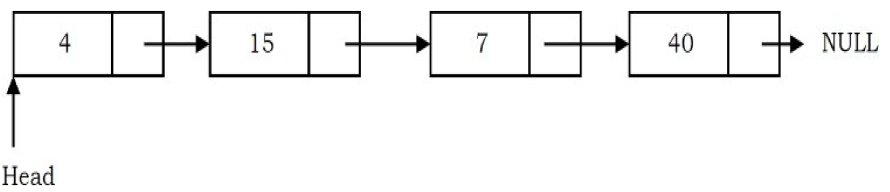
SINGLY LINKED LIST
This list consists of a number of nodes in which each node has a next pointer to the following element. The link of the last node in the list is NULL, which indicates the end of the list.

Slide 24
SINGLY LINKED LIST INSERTION
Inserting a new node before the head (at the beginning)
Inserting a new node after the tail (at the end of the list)
Inserting a new node at a given position of the list

Slide 25
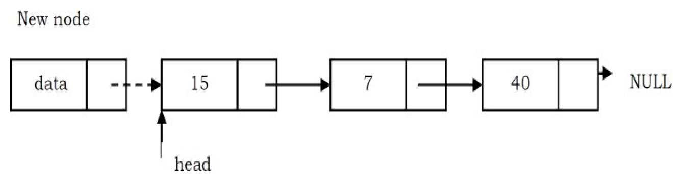
INSERT AN ELEMENT AT THE BEGINNING
In this case, a new node is inserted before the current head node. Only one next pointer needs to be modified (new node’s next pointer) and it can be done in two steps:
Update the next pointer of new node, to point to the current head.

Slide 26
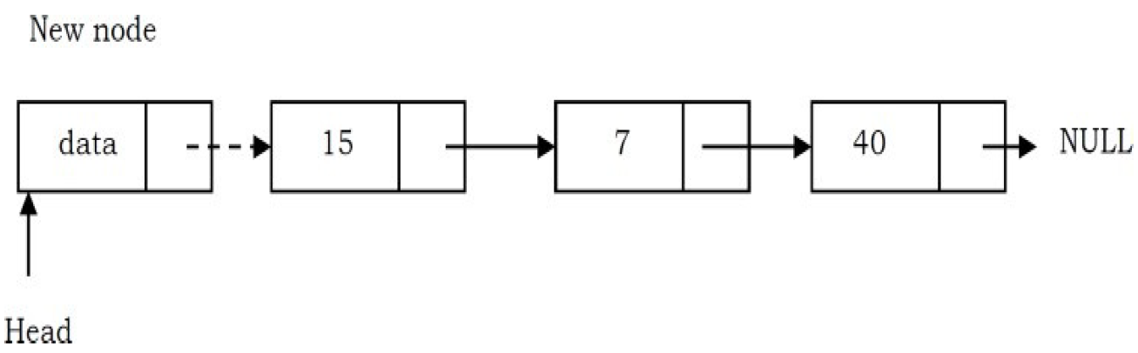
INSERT AN ELEMENT AT THE BEGINNING
Update head pointer to point to the new node.
Let’s code a c program for this insert(insert1.c)

Slide 27
ASSIGNMENT
Inserting a new node after the tail (at the end of the list)
Inserting a new node at a given position of the list
Show the steps for the two inserts and write a c program for the two insertions.

Slide 28
SINGLY LINKED LIST DELETION
Deleting the first node
Deleting the last node
Deleting a node at a given position.

Slide 29
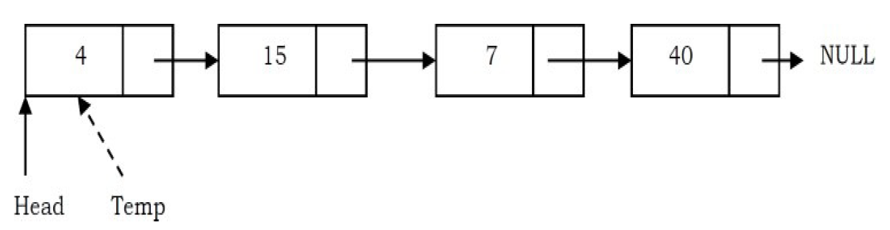
DELETE AN ELEMENT AT THE BEGINNING
First node (current head node) is removed from the list. It can be done in two steps:
Create a temporary node which will point to the same node as that of head.

Slide 30
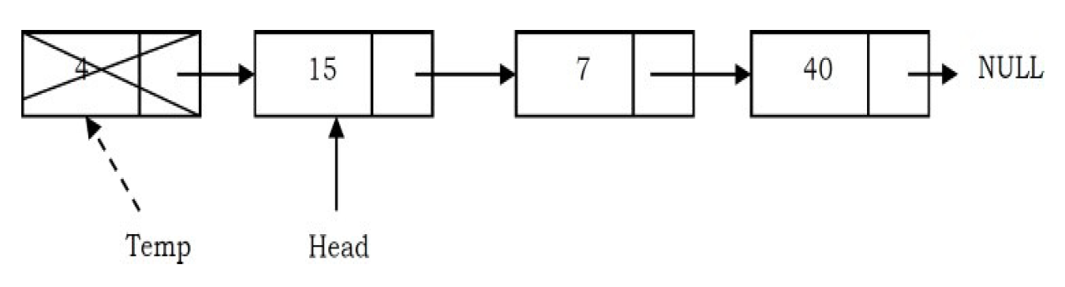
DELETE AN ELEMENT AT THE BEGINNING
Now, move the head nodes pointer to the next node and dispose of the temporary node.
Let’s code a c program for this delete(delete1.c)

Slide 31
Deleting singly linked list
This works by storing the current node in some temporary variable and freeing the current node. After freeing the current node, go to the next node with a temporary variable and repeat this process for all nodes.
Time Complexity: O(n), for scanning the complete list of size n.
Space Complexity: O(1), for creating one temporary variable.

Slide 32
ASSIGNMENT
Deleting the last node
Deleting a node at a given position.
Show the steps to delete those nodes and write a c program for the two deletions

Slide 33
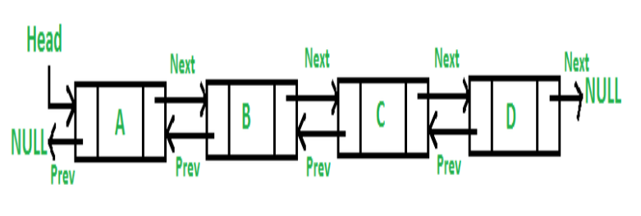
DOUBLY LINKED LIST
A Doubly Linked List (DLL) contains an extra pointer, typically called previous pointer, together with next pointer and data which are there in singly linked list.

Slide 34
DOUBLY LINKED LIST REPRESENTATION
/* Node of a doubly linked list */
_{struct Node {}
_{int data;}
struct Node* next; // Pointer to next node in DLL
struct Node* prev; // Pointer to previous node in DLL
};

Slide 35
ADVANTAGES OF DOUBLY LINKED LIST
1) A DLL can be traversed in both forward and backward direction. 2) The delete operation in DLL is more efficient if pointer to the node to be deleted is given. 3) We can quickly insert a new node before a given node. In singly linked list, to delete a node, pointer to the previous node is needed. To get this previous node, sometimes the list is traversed. In DLL, we can get the previous node using previous pointer.

Slide 36
DISADVANTAGES OF DOUBLY LINKED LIST
1) Every node of DLL Require extra space for an previous pointer. 2) All operations require an extra pointer previous to be maintained. For example, in insertion, we need to modify previous pointers together with next pointers. For example in following functions for insertions at different positions, we need 1 or 2 extra steps to set previous pointer.

Slide 37
DOUBLY LINKED LIST INSERTION
Inserting a new node before the head (at the beginning)
Inserting a new node after the tail (at the end of the list)
Inserting a new node at a given position of the list

Slide 38
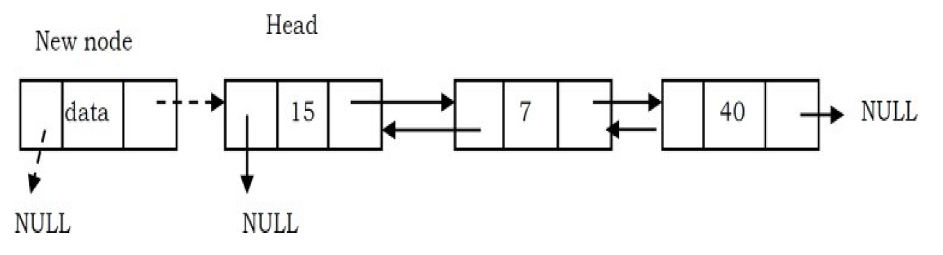
INSERT AN ELEMENT AT THE BEGINNING
In this case, new node is inserted before the head node. Previous and next pointers need to be modified and it can be done in two steps:
Update the right pointer of the new node to point to the current head node (dotted link in below figure) and also make left pointer of new node as NULL.

Slide 39
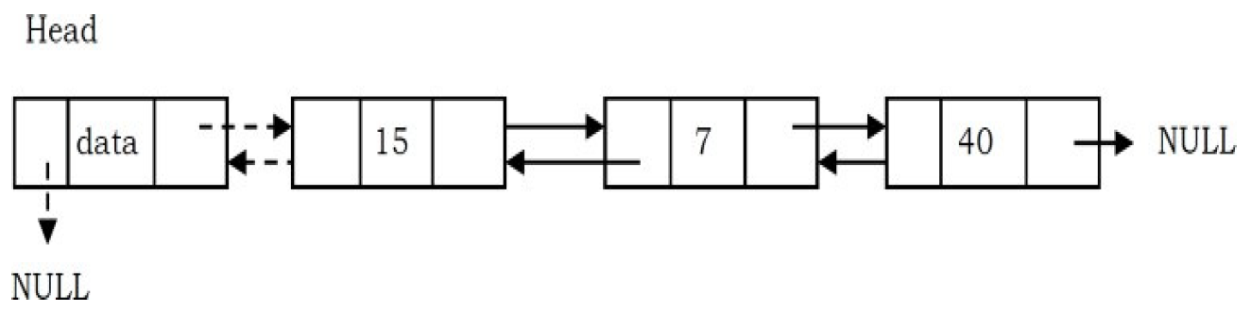
INSERT AN ELEMENT AT THE BEGINNING
Update head node’s left pointer to point to the new node and make new node as head.
Let’s code a c program for this insert(insert2.c)

Slide 40
INSERT AN ELEMENT
Time Complexity: O(n). In the worst case, we may need to insert the node at the end of the list.
Space Complexity: O(1), for creating one temporary variable.

Slide 41
ASSIGNMENT
Inserting a new node after the tail (at the end of the list)
Inserting a new node at a given position of the list
Show the steps for the two inserts and write a c program for the two insertions.

Slide 42
DOUBLY LINKED LIST DELETION
Deleting the first node
Deleting the last node
Deleting a node at a given position.

Slide 43
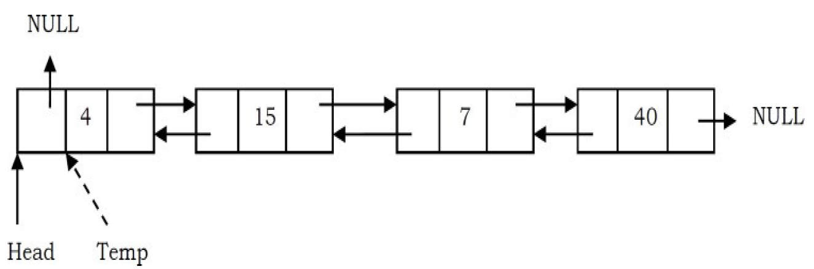
DELETE AN ELEMENT AT THE BEGINNING
In this case, the first node (current head node) is removed from the list. It can be done in two steps:
Create a temporary node which will point to the same node as that of head.

Slide 44
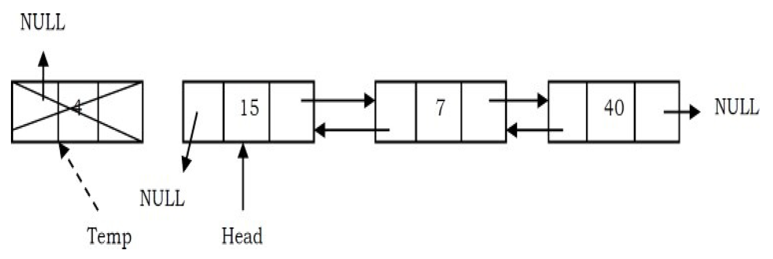
DELETE AN ELEMENT AT THE BEGINNING
Now, move the head nodes pointer to the next node and change the heads left pointer to NULL. Then, dispose of the temporary node.
Let’s code a c program for this delete(delete2.c)

Slide 45
Deleting singly linked list
Time Complexity: O(n), for scanning the complete list of size n.
Space Complexity: O(1), for creating one temporary variable.

Slide 46
ASSIGNMENT
Deleting the last node
Deleting a node at a given position.
Show the steps to delete those nodes and write a c program for the two deletions

Slide 47
CIRCULAR LINKED LIST
In singly linked lists and doubly linked lists, the end of lists are indicated with NULL value. But circular linked lists do not have ends. While traversing the circular linked lists we should be careful; otherwise we will be traversing the list infinitely. In circular linked lists, each node has a successor. Note that unlike singly linked lists, there is no node with NULL pointer in a circularly linked list. In some situations, circular linked lists are useful.

Slide 48
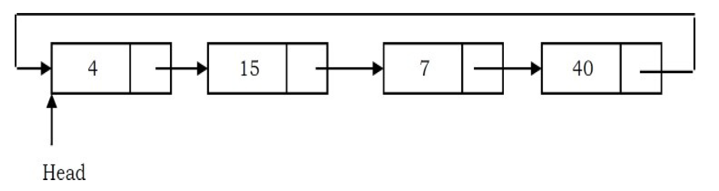
CIRCULAR LINKED LIST

Slide 49
ADVANTAGES OF CIRCULAR LINKED LIST
1) Any node can be a starting point. We can traverse the whole list by starting from any point. We just need to stop when the first visited node is visited again.
2) Useful for implementation of queue. Unlike this implementation, we don’t need to maintain two pointers for front and rear if we use circular linked list. We can maintain a pointer to the last inserted node and front can always be obtained as next of last.

Slide 50
TRAVERSING CIRCULAR LINKED LIST
We assume here that the list is being accessed by its head node. Since all the nodes are arranged in a circular fashion, the tail node of the list will be the node previous to the head node. Let us assume we want to print the contents of the nodes starting with the head node. Print its contents, move to the next node and continue printing till we reach the head node again.

Slide 51
TRAVERSING CIRCULAR LINKED LIST
In a conventional linked list, we traverse the list from the head node and stop the traversal when we reach NULL. In a circular linked list, we stop traversal when we reach the first node again. Following is the C code for the linked list traversal.
Lets program it in c (traversal2.c)

Slide 52
CIRCULAR LINKED LIST INSERTION
Insertion in an empty list
Insertion at the beginning of the list
Insertion at the end of the list
Insertion in between the nodes

Slide 53
INSERT AN ELEMENT AT THE BEGINNING
To insert a node at the beginning of the list, follow these steps: 1. Create a node, say T. 2. Make T -> next = last -> next. 3. last -> next = T.

Slide 54
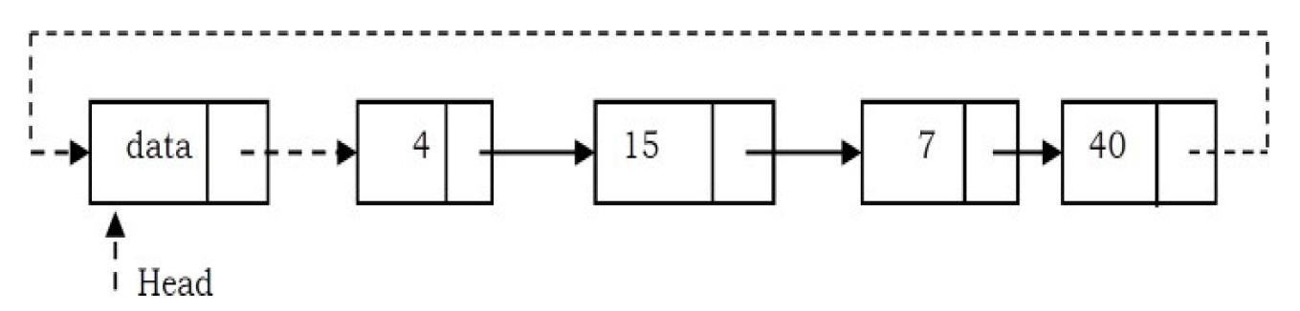
INSERT AN ELEMENT AT THE BEGINNING
Make the new node as the head.

Slide 55
INSERT AN ELEMENT
Time Complexity: O(n), for scanning the complete list of size n.
Space Complexity: O(1), for temporary variable.

Slide 56
ASSIGNMENT
Inserting a new node at the beginning
Inserting a new node after the tail (at the end of the list)
Inserting a new node at a given position of the list
Show the steps for the inserts and write a c program for the insertions.

Slide 57
CIRCULAR LINKED LIST DELETION
Deleting the first node
Deleting the last node
Deleting a node at a given position.

Slide 58
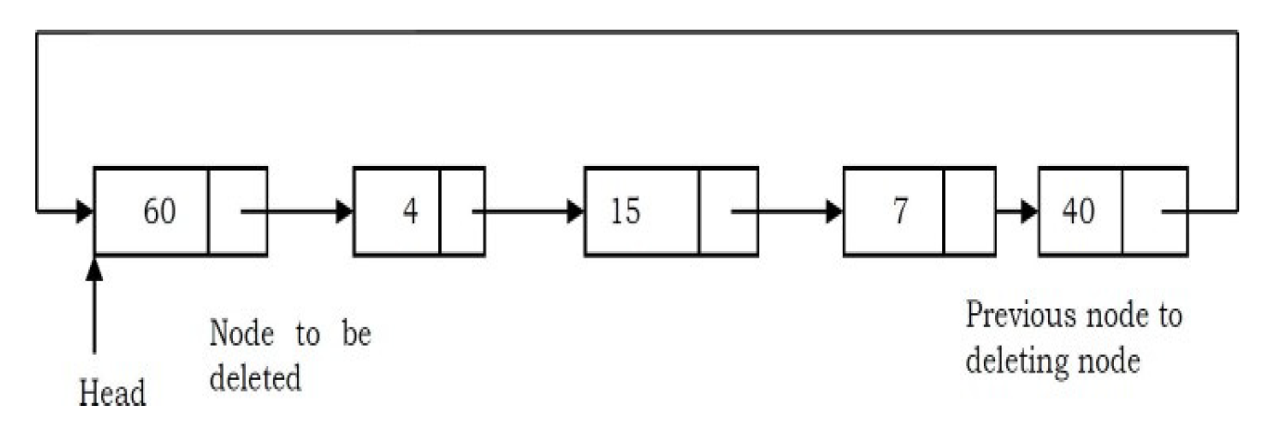
DELETE AN ELEMENT AT THE BEGINNING
The first node can be deleted by simply replacing the next field of the tail node with the next field of the first node.
Find the tail node of the linked list by traversing the list. Tail node is the previous node to the head node which we want to delete.

Slide 59
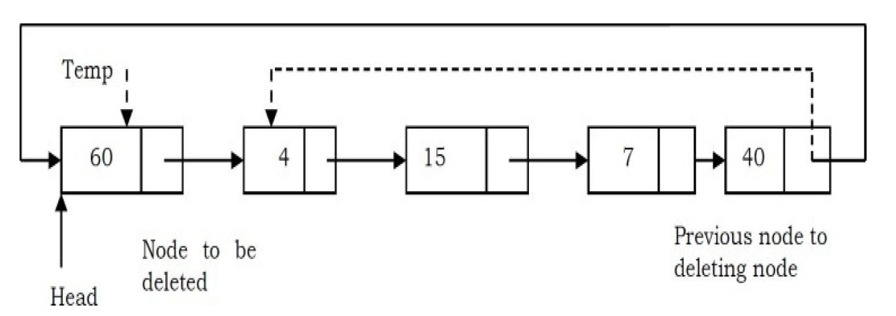
DELETE AN ELEMENT AT THE BEGINNING
Create a temporary node which will point to the head. Also, update the tail nodes next pointer to point to next node of head (as shown below).

Slide 60
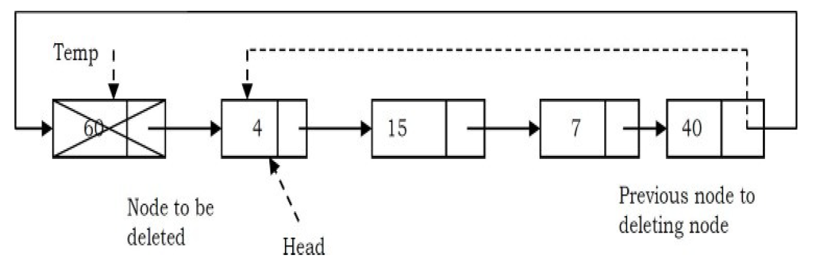
DELETE AN ELEMENT AT THE BEGINNING
Now, move the head pointer to next node. Create a temporary node which will point to head. Also, update the tail nodes next pointer to point to next node of head (as shown below).

Slide 61
Deleting singly linked list
Time Complexity: O(n), for scanning the complete list of size n.
Space Complexity: O(1), for a temporary variable.

Slide 62
ASSIGNMENT
Deleting the first node
Deleting the last node
Deleting a node at a given position.
Show the steps to delete those nodes and write a c program for the deletions

Slide 63
REFERENCES
https://www.geeksforgeeks.org/
Data Structures And Algorithms Made Easy: Data Structures And Algorithmic Puzzles by Narasimha Karumanchi

